Slide 1
Healtha APP
Healthcare recommendation system and lab analysis application
Supervisors:
Dr. Tarek Mustafa
Dr. Ahmed Gamal

Slide 2
07. Team Members
Sara Samir
Aya Elmallah
Esraa Maged
Iptihal Yousri
Rahma Khaled
Habiba Mohammed

Slide 3
TABLE OF CONTENTS
01.
02.
04.
Problem, Solution, Internships
Literature Reveiws
03.
System Features
Diagrams
05.
06.
Used technologies
07.
Healtha UI
AI Models

Slide 4
01.1 Problem Statement

Slide 5
Problem Statement
Understanding complex lab analysis results poses a significant challenge for many individuals, as the technical language used can cause confusion and anxiety, particularly for those with disabilities. Accessibility issues further hinder some individuals from comprehending their health data.

Slide 6
02.2
Obtained Solution

Slide 7
Obtained Solution
- To address this challenge, we propose the development of an innovative app that harnesses the power of AI models to enhance user understanding of lab analyses, including critical tests. The application utilizes advanced Language Models (LLM) and Generative AI to transform technical information into user-friendly explanations. By prioritizing accessibility, the app ensures that everyone, including those with disabilities, can easily interpret and engage with their health data.

Slide 8
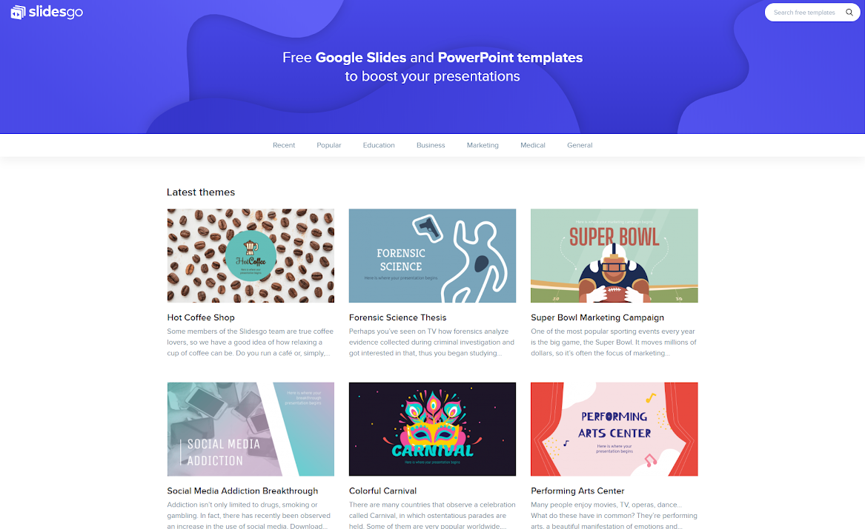
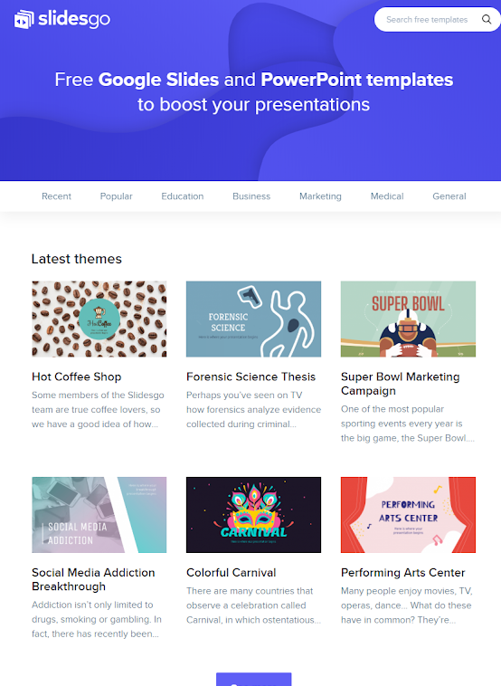
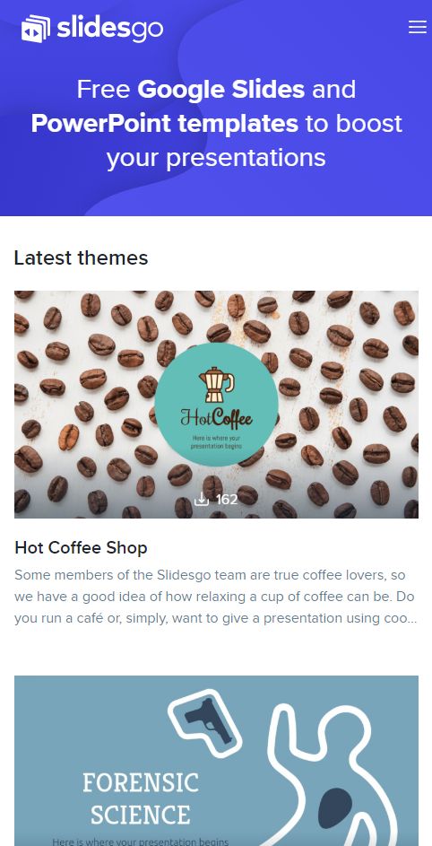
This solution has been proposed to
different internship associations such as:
1. Industrial Graduation Project (IGP)
2. Entrepreneurial Graduation Project (EGP)internship

Slide 9
02. Literature Reviews

Slide 10
Literature Reviews
Meaning of Literature reviews :
Literature reviews are detailed examinations of previously published literature on a specific topic. They provide a comprehensive analysis of existing research, helping to establish the current knowledge and understanding of a subject. Literature reviews are essential for identifying gaps or areas requiring further investigation, making them a vital part of academic and research projects.

Slide 11
Literature Reviews
in paper[1]: Artificial intelligence (AI) is being increasingly applied in healthcare systems, including laboratory medicine. AI can automate decision-making and support various functions such as image analysis, genomics, test utilization, error detection, and result interpretation. In the future, AI is expected to play a more significant role in clinical laboratories. Laboratorians have opportunities to participate in the creation of AI algorithms, and it is crucial to consider important factors while implementing and evaluating AI algorithms.

Slide 12
Literature Reviews
in paper[2]: Artificial intelligence is being increasingly used in medical diagnostics and has the potential to revolutionize healthcare. AI could act as the first point of contact for patients, freeing up medical staff to focus on complex treatments. However, AI systems must not only accurately diagnose and predict problems but also explain their process to medical professionals and patients. Without this transparency, legitimate diagnoses and treatments may be ignored or dismissed.

Slide 13
Literature Reviews
in paper[3]:The use of automated image caption algorithms in medical image processing can greatly assist physicians in quickly and effortlessly diagnosing patients. However, current methods overlook the accuracy of pathological information in the generated reports. To address this issue, a detection model and a diagnosis generation model are proposed to extract precise pathological data from medical images and generate accurate diagnostic reports. This advancement in computer-aided diagnosis and deep learning promotes the use of computer algorithms to automatically generate more precise diagnostic reports in medical image analysis.

Slide 14
03.
System Features

Slide 15
Intended users
- Normal users
- Doctors
- Users with special needs

Slide 16
App features
Lab test results interpretation: Clear and concise explanations confirmed by specialized doctors of lab results provided with a Visualizations
Recommendation and Prediction System: Recommend Medical specialty and optional the disease that suit the patient symptoms.
Nearest Doctor Location: Collecting the doctors’ or hospitals’ location to recommend the nearest for the users.
Chatbot: support you to know all information needed about a distinct disease , related symptoms or its treatments via a Chabot feature implemented through the app.
Medical Lab Tests Encyclopedias: A comprehensive encyclopedia for all information needed about medical lab tests.
Diseases Encyclopedia: A comprehensive encyclopedia for all diseases.

Slide 17
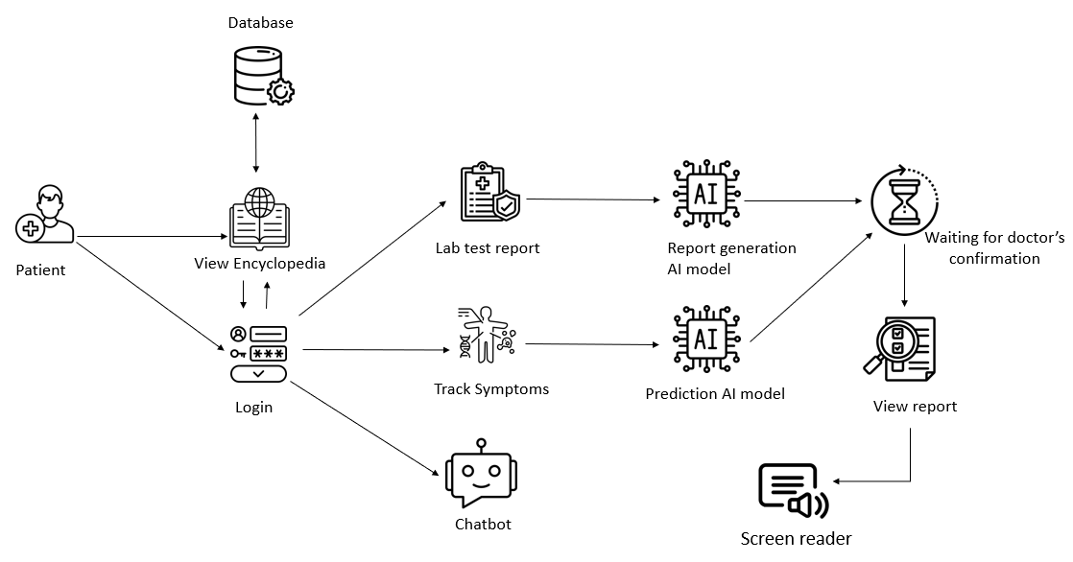
How it works diagram

Slide 18
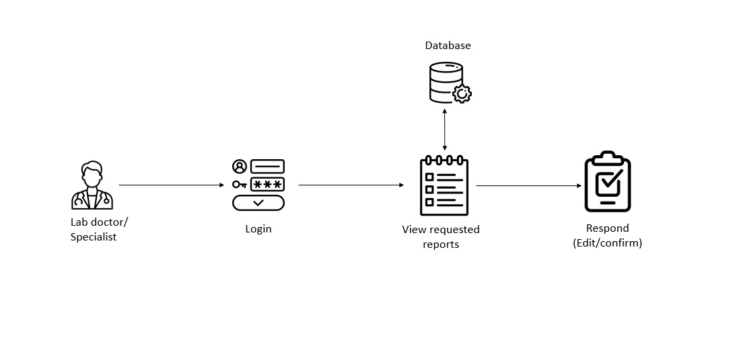
How it works diagram

Slide 19
Accessibility
Accessibility features for users with special needs::
Lab reader support.
Text size and font customization
High contrast mode.
Gesture support.

Slide 20
User added value
Besides these system features, we conducted a survey in collaboration with individuals from various professional backgrounds. The majority expressed satisfaction and demonstrated a need for such an application.
Mona Mohammed | Housewife | والله ي ريت هيكون حاجة كويسة جدا وانا بالنسبالي هتفيدني اوي وبدل الشحططة, دا هيسهل علينا كتير
Mohammed Ali | Teacher | اعتقد ان نطبيق بكل المميزات دي سوف يلاقي اهمية كبيرة في السوق المحلي والخارجي وعند ترجمته لباقي اللغات
Asmaa | Teacher | من اين استطيع ان احمل هدا التطبيق؟ او ما هي المعامل المتعاقدون معها؟ برجاء سرعة الرد
Maged Soliman | Manager | من رؤيتي كمدير حسابات, هدة ليست فكرة انها بالعفل بداية لمشروع ناشئ
Ahmed Nassar | Doctor | As a doctor, it is a good idea but it will be useless if it lacks to the human consultation. You to collaborate with doctors and if it done, that would be great.
Eman Ayman |  | هوانا الي بكتب الكلام دا نيابة عن ماما بس هي بتقولكوا انها ي ريت يبقي فيه حاجة زي دي لانها بتعاني حتي و حد يجي بقرألها التحاليل فلوفعلا ينفع التطبيق يقرأهالها وانا هعلمها تشغله ازاي وبتقولكوا الاشتراك بكام ويريت يبقي زي النوادي كدا فترة طويلة الواحد مش بيحلل كل يوم

Slide 21
University added value
The Genetics Institute at the University
Laboratories for medical analysis under contract with the university.

Slide 22
04.
Diagrams

Slide 23
05. Used Technologies

Slide 24
Used Technologies
- Flutter
- Langchain
- Machine Learning (sklearn, tenserflow)

Slide 25
06. Healtha pages

Slide 26

Splash screen
Normal users UI

Slide 27
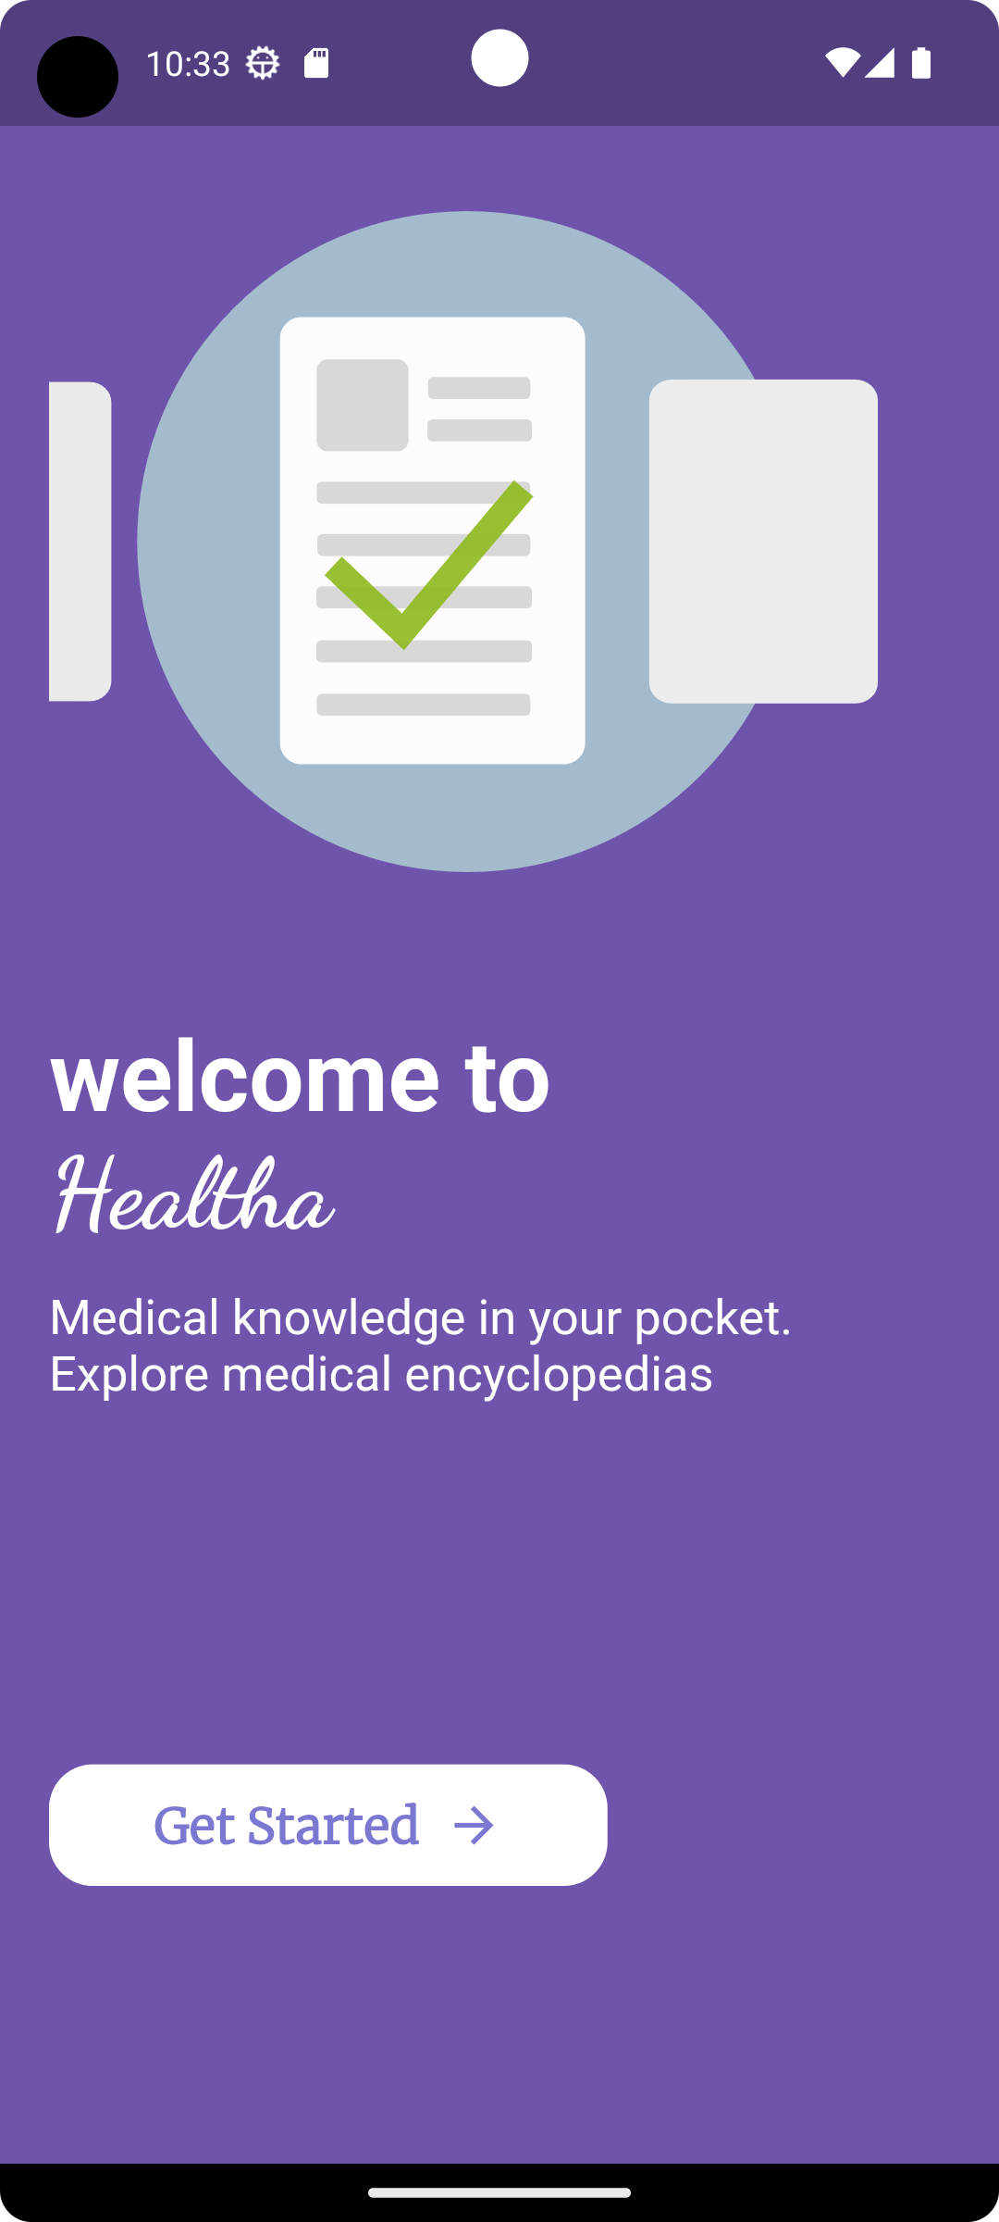
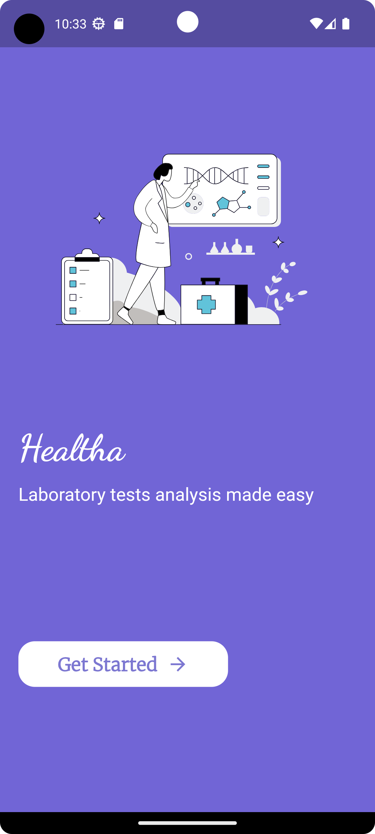
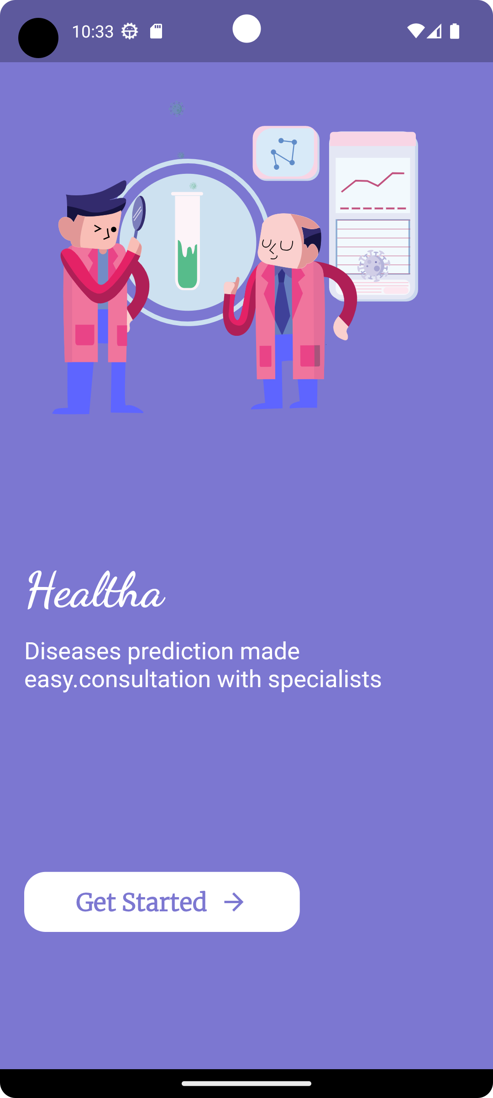
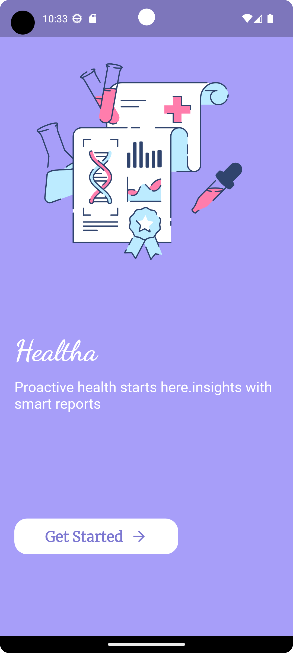
Slider screens

Slide 28
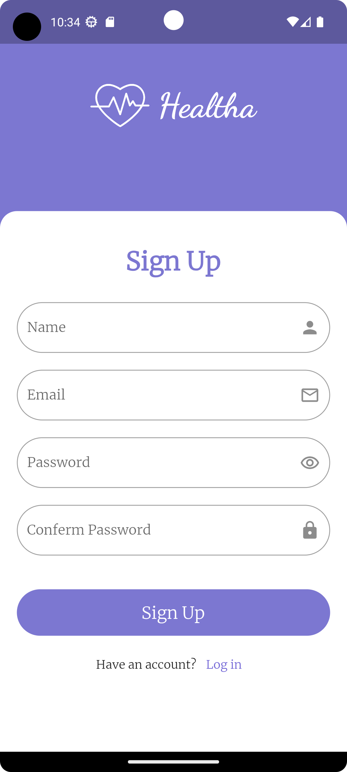
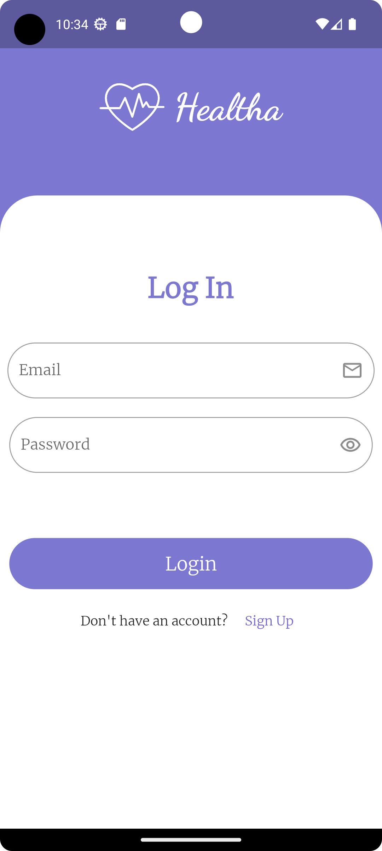
Sign up & Login

Slide 29
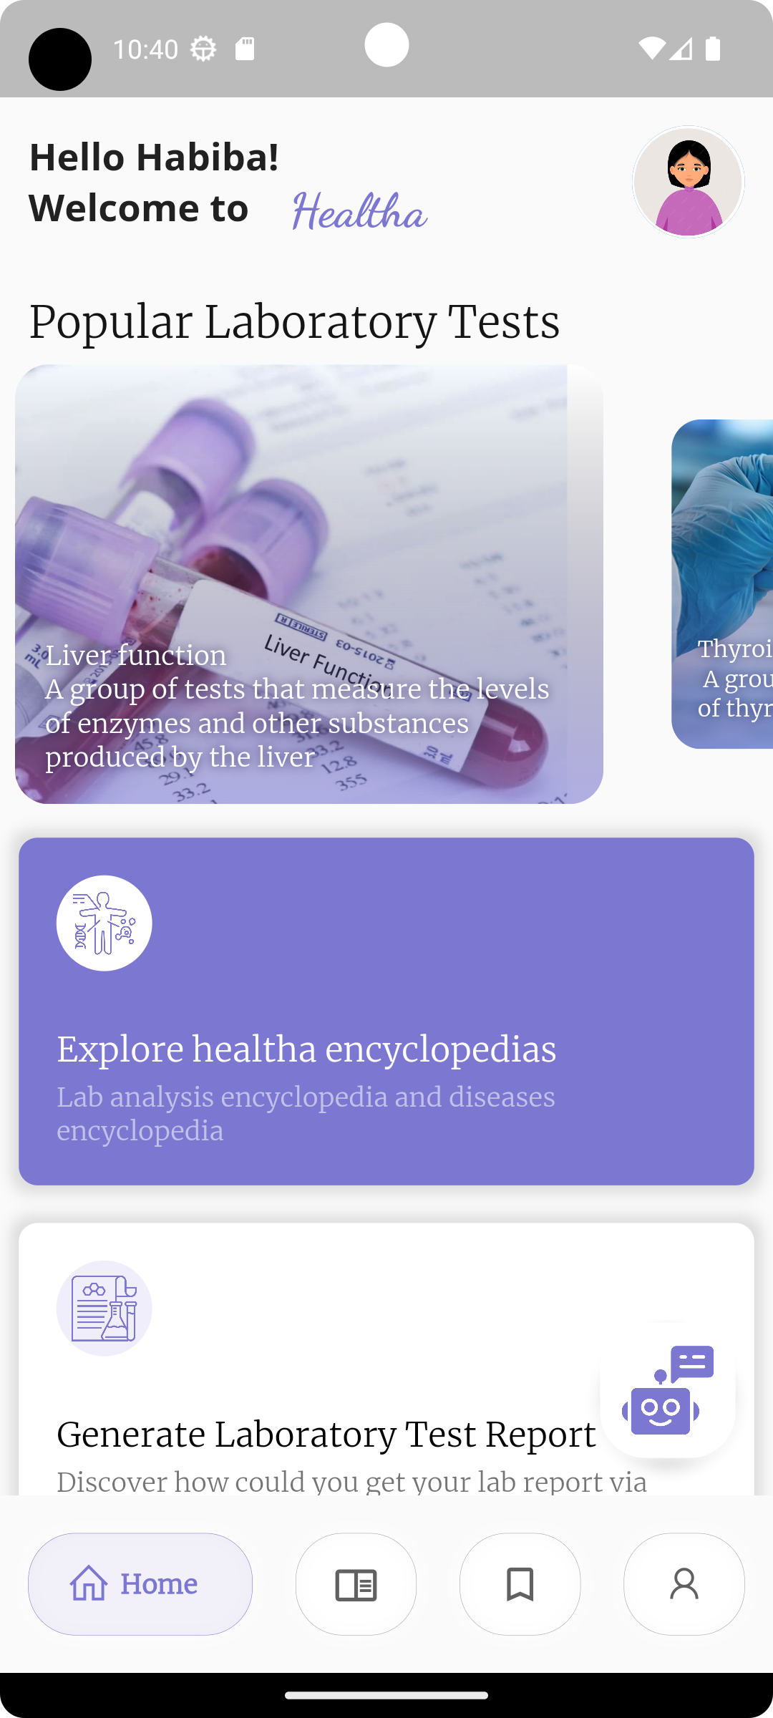
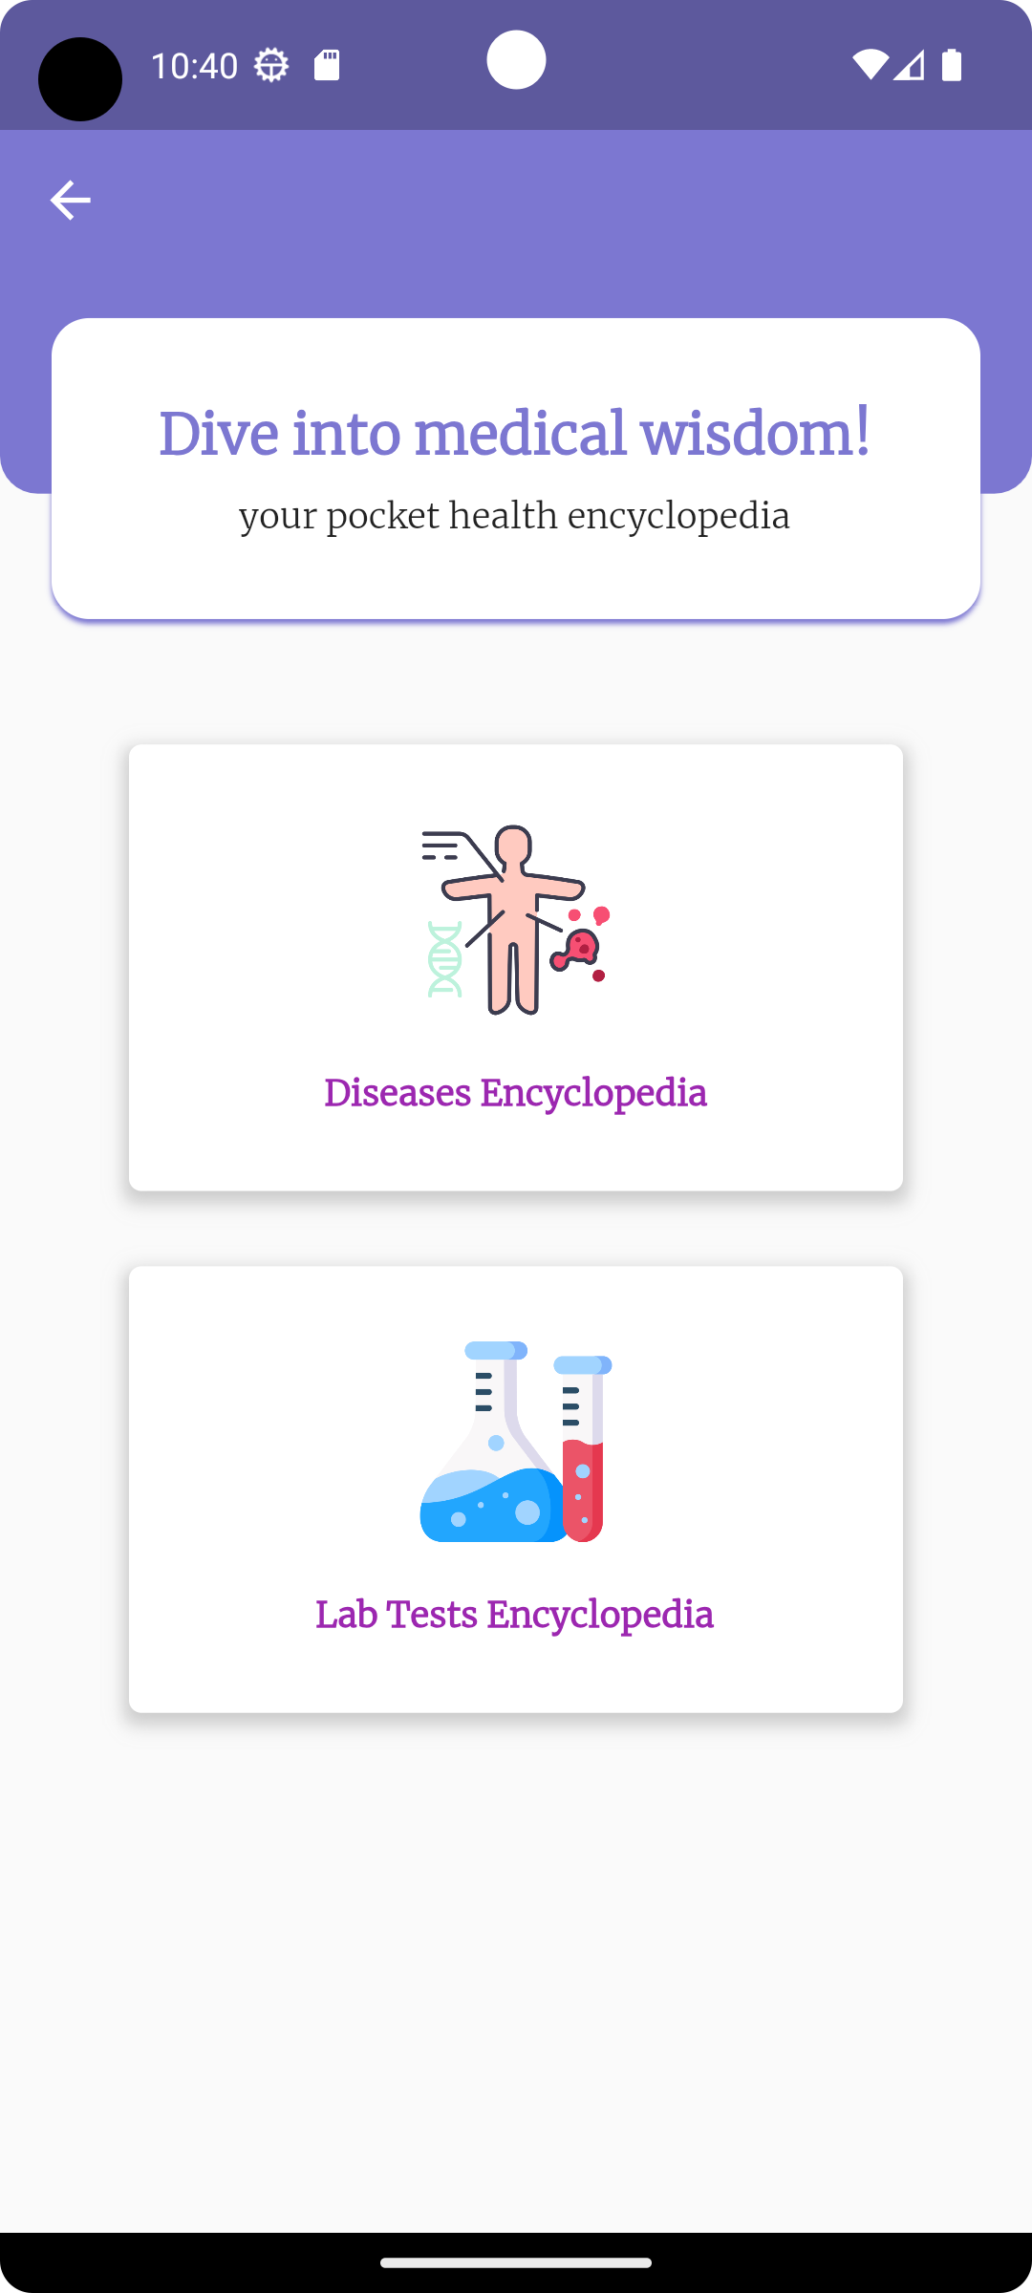
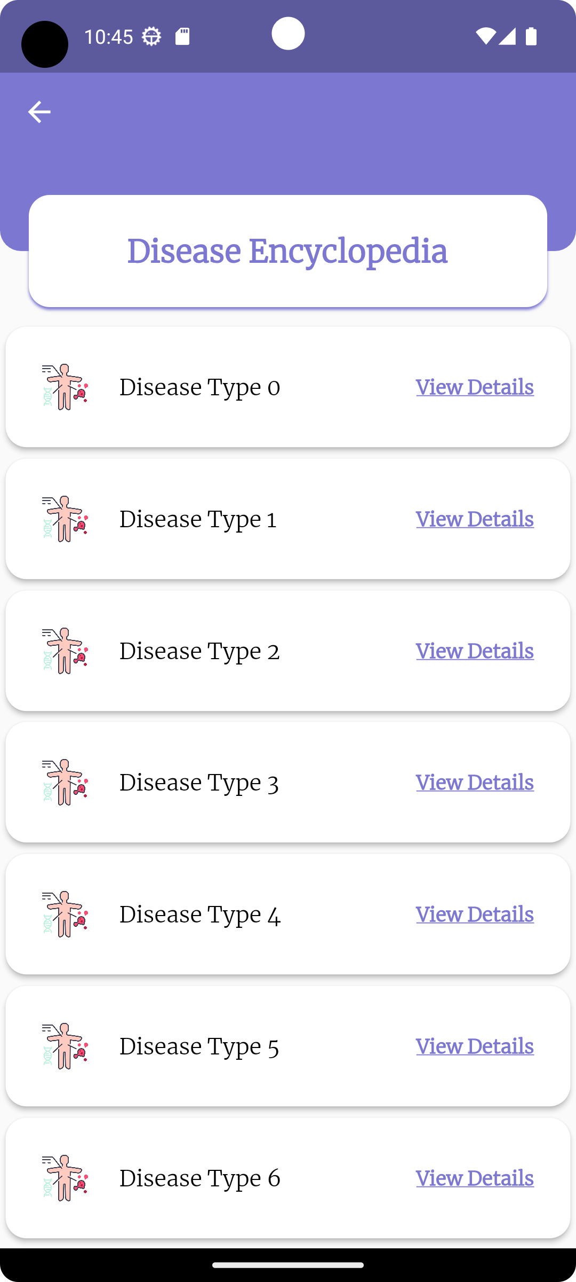
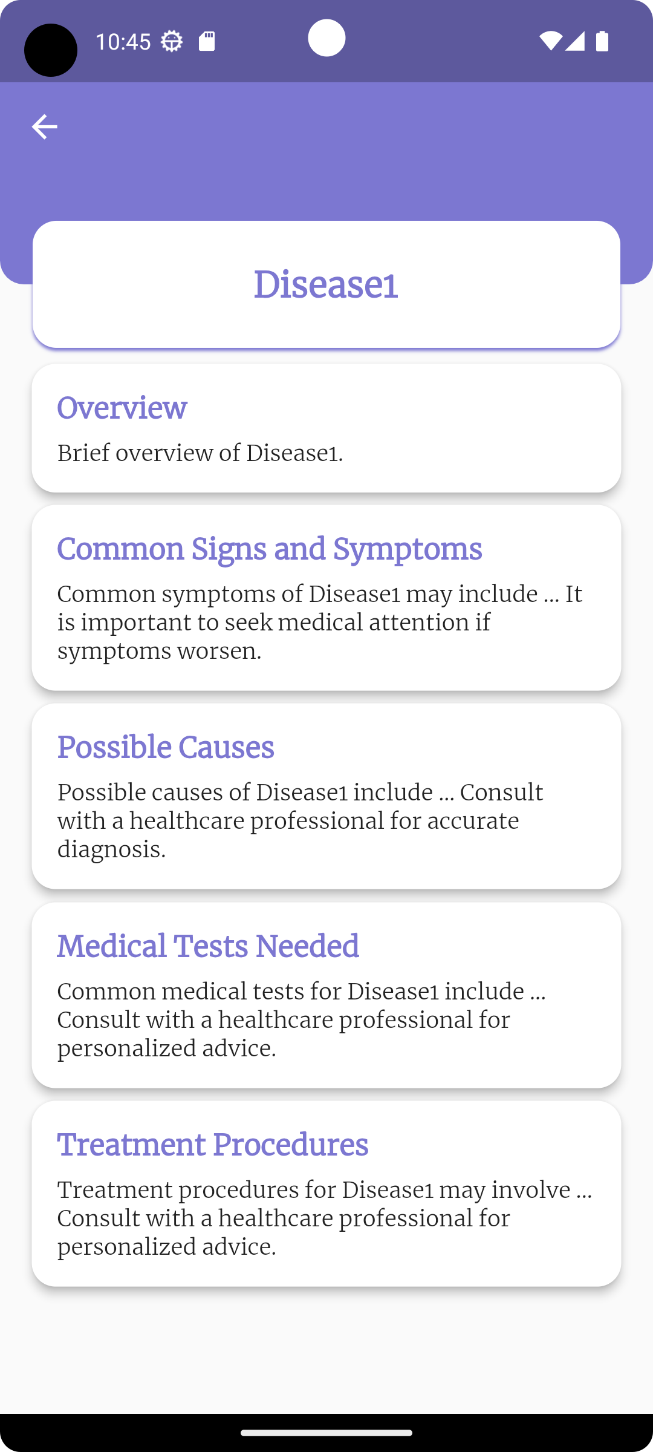
Home
Encyclopedia screens

Slide 30
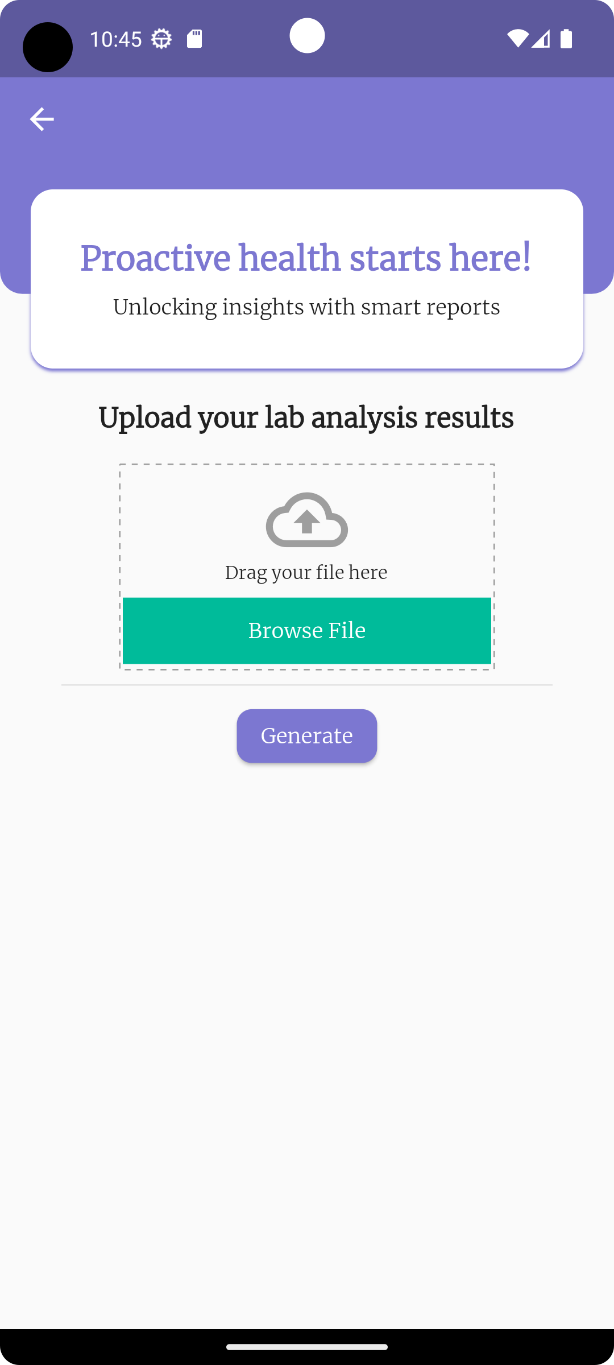
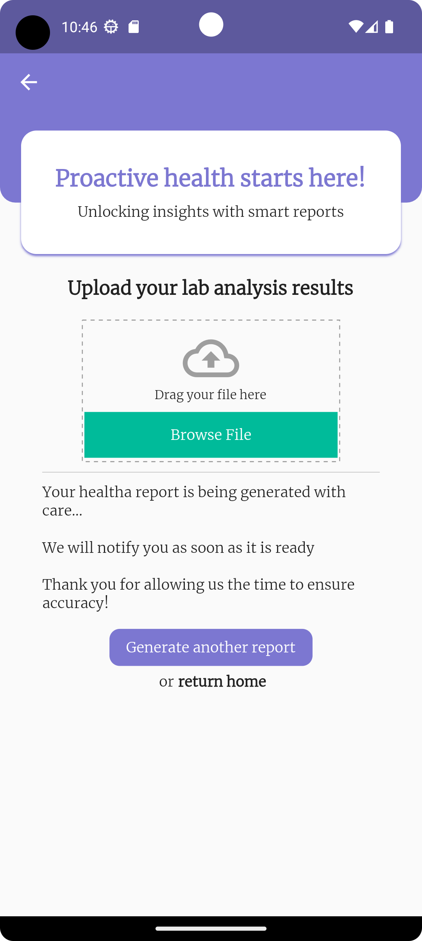
Upload lab analysis & Generate report screen

Slide 31
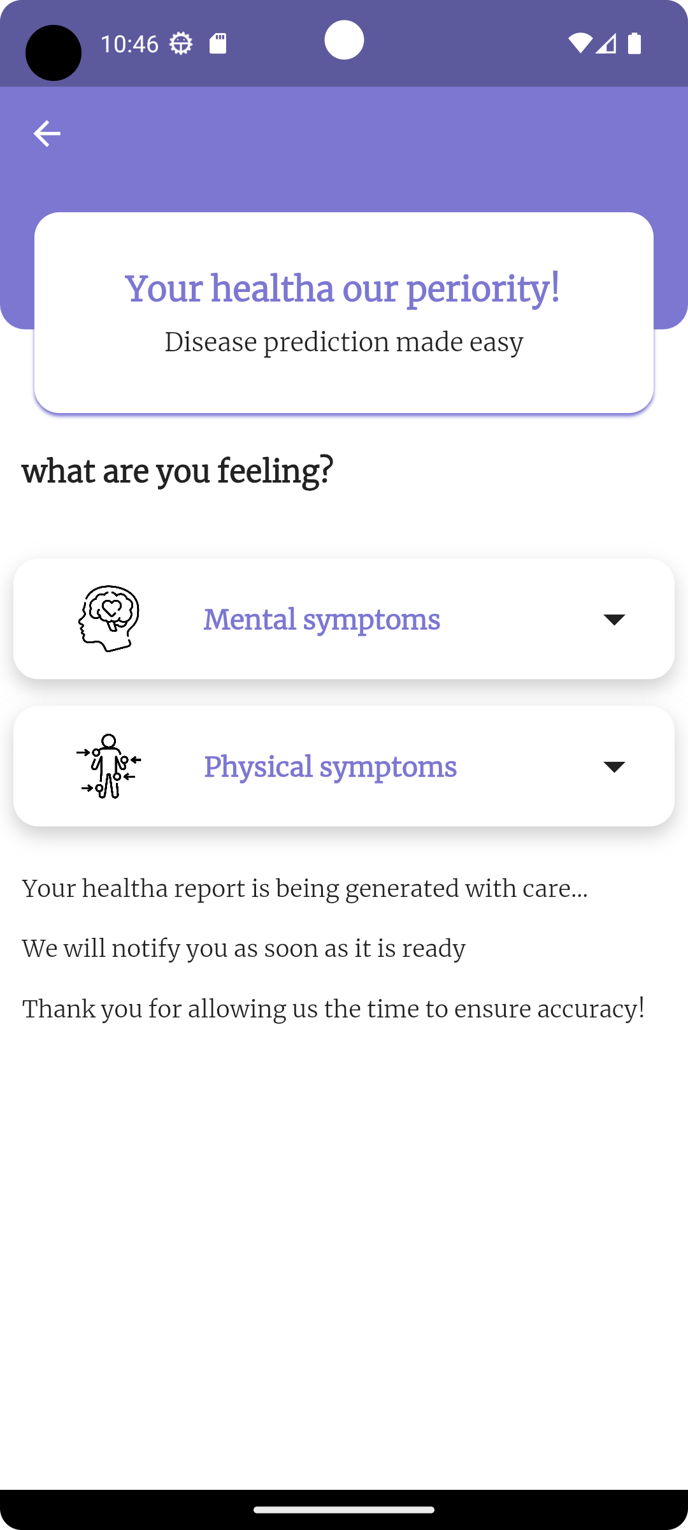
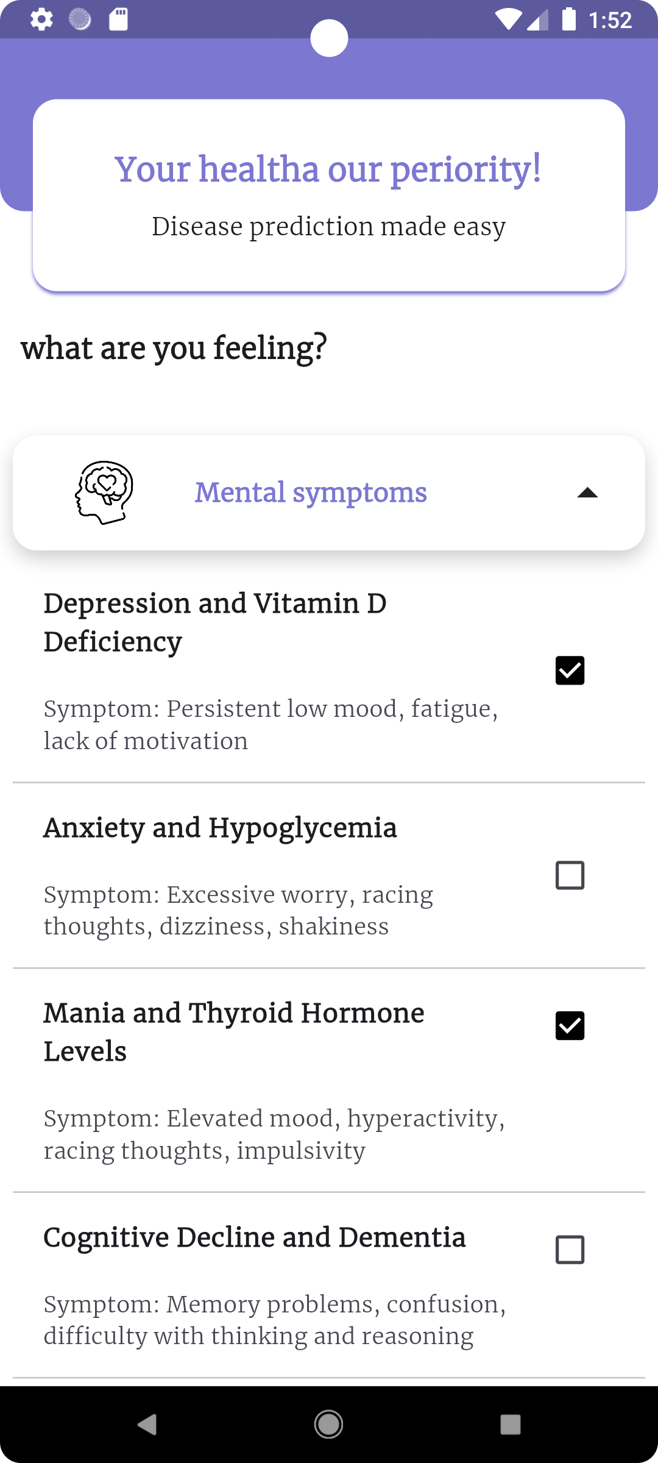
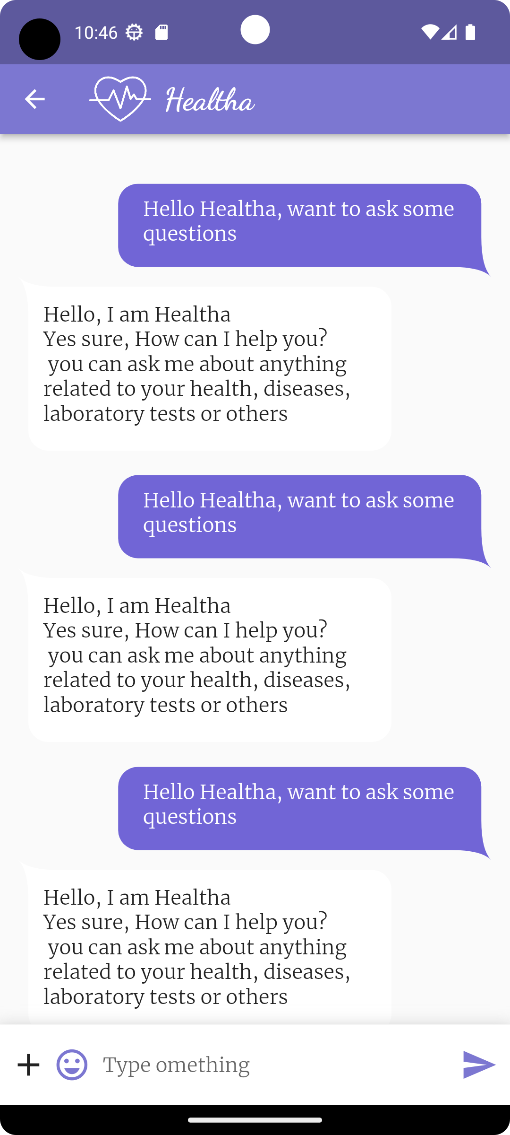
Prediction screens
Chatbot

Slide 32
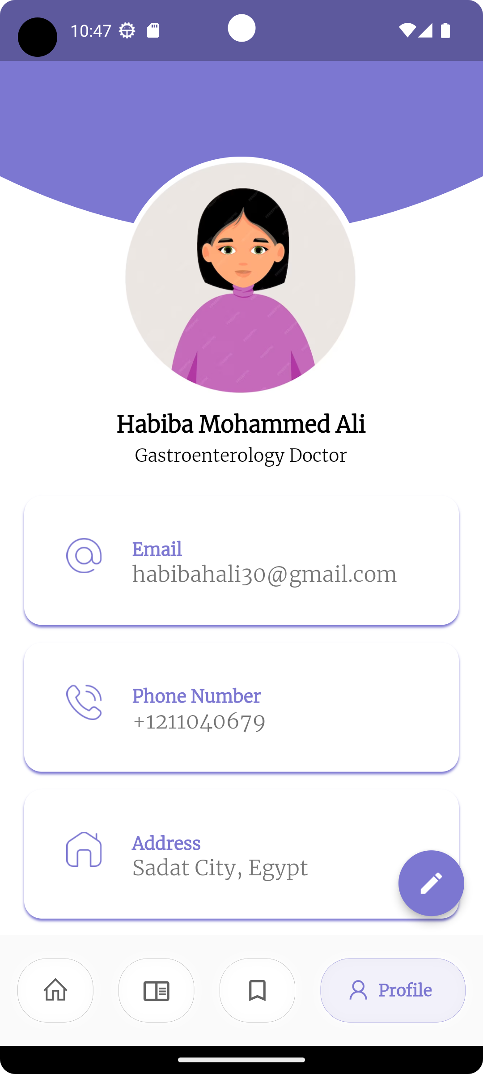
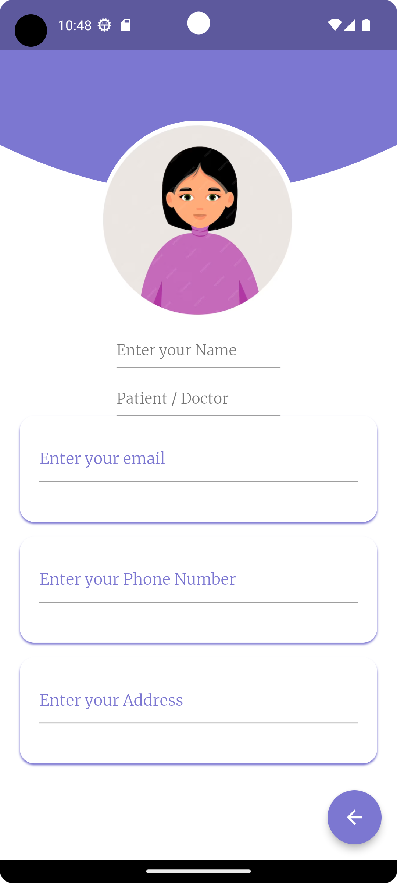
Profile screens

Slide 33
Thank you!

